Slide 1
a mission of hope and healing

Slide 2
Partners in
hope & healing

Slide 4
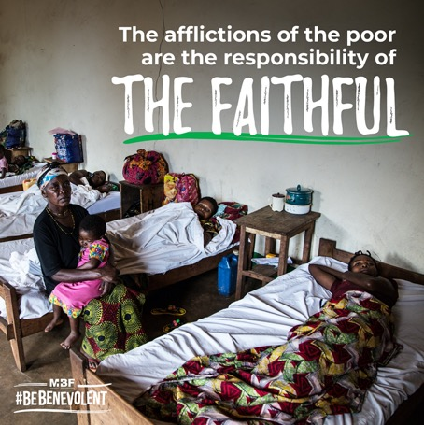
Ministry Impact 2020

Slide 5
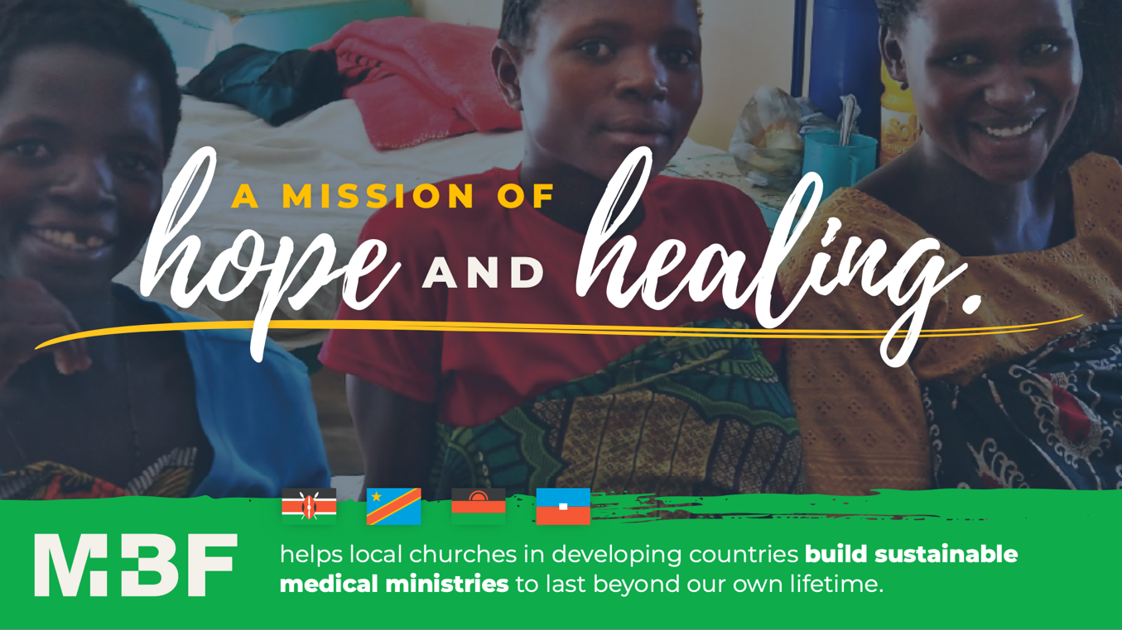

Slide 6
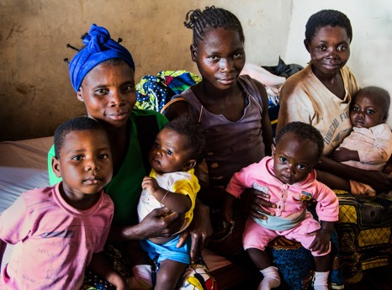
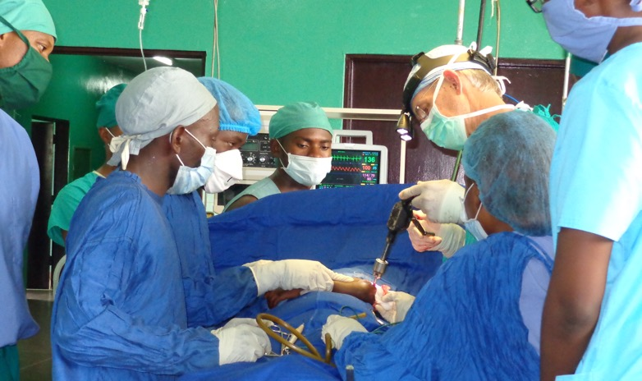
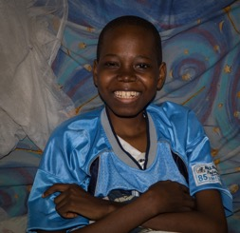
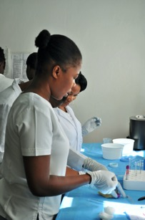
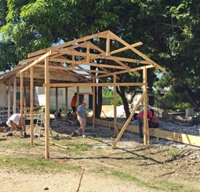
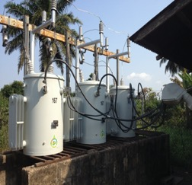
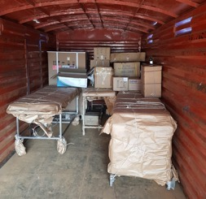
Medical care for impoverished women and children
Surgical and specialty residencies.
Life-saving surgeries, even for those who cannot pay.
Pediatric Rehab
BE BENEVOLENT
Nursing Scholarships
Modernize facilities and provide equipment and supplies

Slide 7
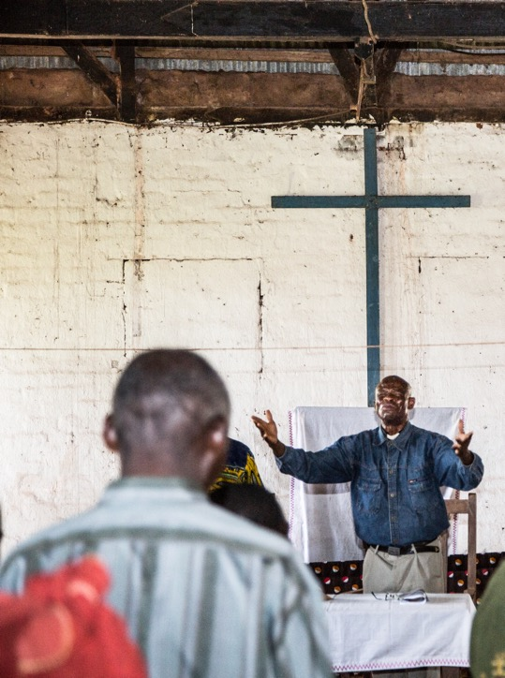
Medical ministries of local churches in developing countries provide
30% - 50%
of all medical care.
3,000
MBF works with these ministries to:
Local churches
Share the Gospel of Christ
Prevent deaths
Work to become sustainable
Give hearts hope
Provide quality medical care
Create jobs
Provide care for the poor
Heal the sick
Train young people
Glorify God

Slide 8

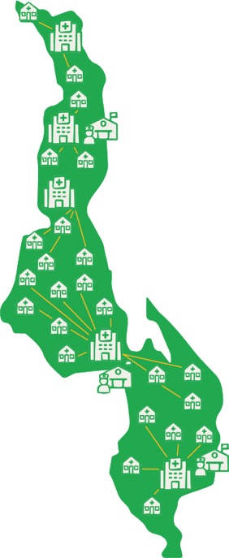
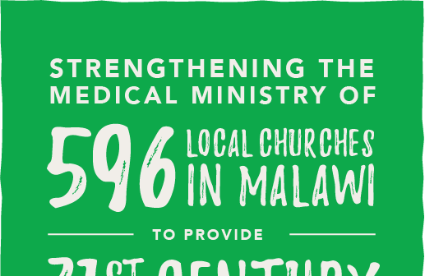
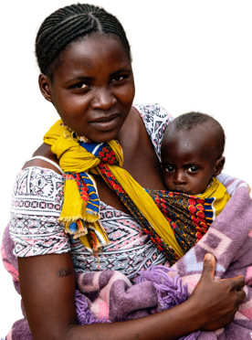
BUILDING A CHRISTIAN MEDICAL NETWORK IN MALAWI
5 Hospitals
3 Nursing Schools
24 Clinics
The first-ever country-wide Christian medical network in Malawi will improve care, reduce costs, and make the ministries sustainable for the long-run. It is supported by
local medical and religious leaders, MBF, and 6 other medical mission-minded organizations. We need help to make it a lasting reality for the people of Malawi.
Under the auspices of 3 Presbyterian synods in Malawi
Uniting to form a country-wide Christian Medical Network

Slide 9
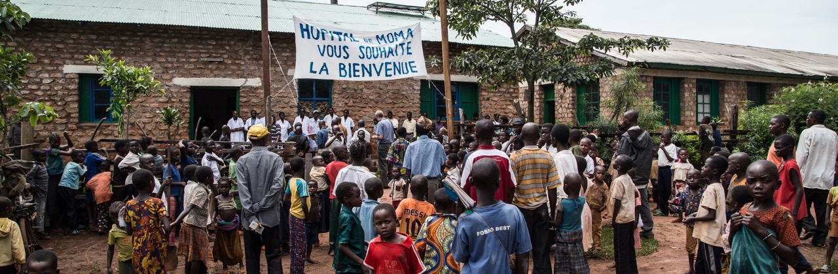

Help provide hope and healing
through medical mission

Slide 10


