Slide 1








Raising the profile of nurses in LMIC settings through research
David Gathara, PhD, RN
Notes:
Work developed in collaboration with the county

Slide 2

Why a focus on nursing ?
Nurses provide most of primary care to patients (leader of the care team)
  First connection in most any setting
  Knows diagnosis, plan of care, desired outcome
  Knows Patient vulnerabilities
  Last connection in most any setting
Nurses are among the most trusted care-givers
Nurses facilitate Care Coordination: internal & external
The Triple Impact Report on Nursing concludes that strengthening nursing globally would have a triple impact of improving health, improving gender equality by empowering women and building stronger economies. Universal Health Coverage will not be achieved unless nursing is strengthened.
Notes:
Recognize “how things work” – and why
Know who is responsible
Ensure transfer of correct information
Provide patient support to wellness—
Track referrals & help resolve problems
Lead your Team to excellent patient service
Help patients identify sources of service & make appointments

Slide 3

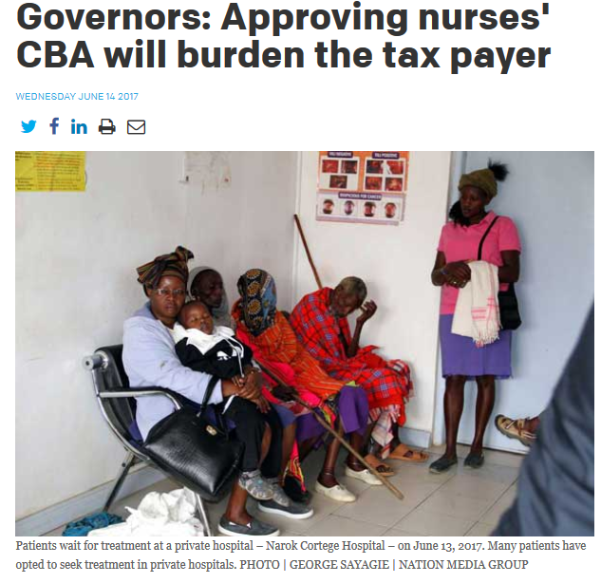


How are nurses valued/seen in LMICs?
We need to change this narrative!

Slide 4


Why the Interest in nursing research?
Nurses are largest component of the health professional workforce and are recognized as essential to the delivery of safe and effective care
However, nurses’ 'voice' in discussion on major human resource issues and on quality of care (QoC) has been shown to be often lacking
Poor and limited involvement in decision making is linked to a number of things;
  lack of recognition of nurses as key stakeholders in policy development, a negative image of nursing as 'only an assisting profession', and bureaucratic processes.

Slide 5
Nursing and improving QoC
Most efforts to evaluate QoC in LMIC focus almost exclusively on more medical aspects of care BUT
    In larger facilities nurses’ roles complement those of physicians and clinical officers.
    Nurses are gate keepers of the delivery of medical interventions (e.g. treatments, nutrition interventions etc.), they initiate interventions e.g. KMC and responsible for holistic care to address wider patient needs
In LMIC facilities, large patient workloads, insufficient staff and resources (among other factors) might result in nursing care being delayed, rationed or neglected - ‘missed care’
Therefore our focus is on;
    Measuring how much nursing work nurses do with an aim of producing measurements of nursing quality
    Examining how the nursing profession use the above measures of quality in decision making about workforce issues
Notes:
But this needs to be accompanied by standards

Slide 6
What have we done so far?

Slide 7
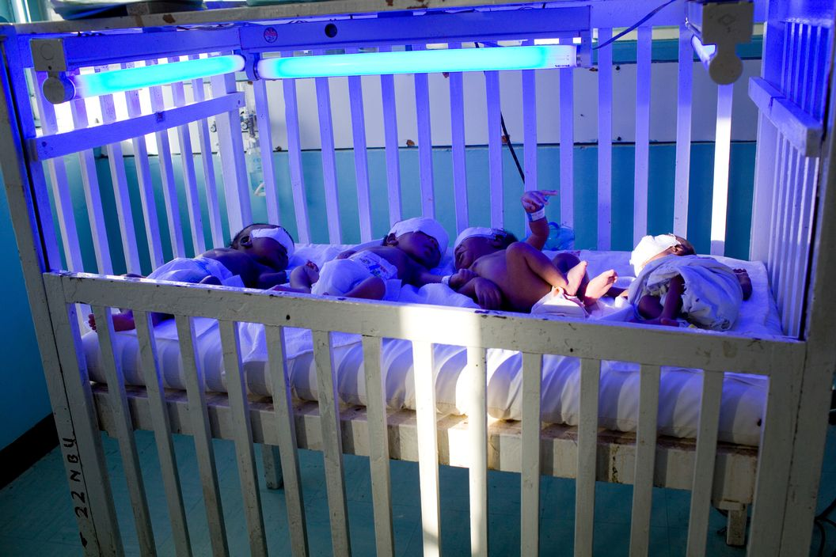
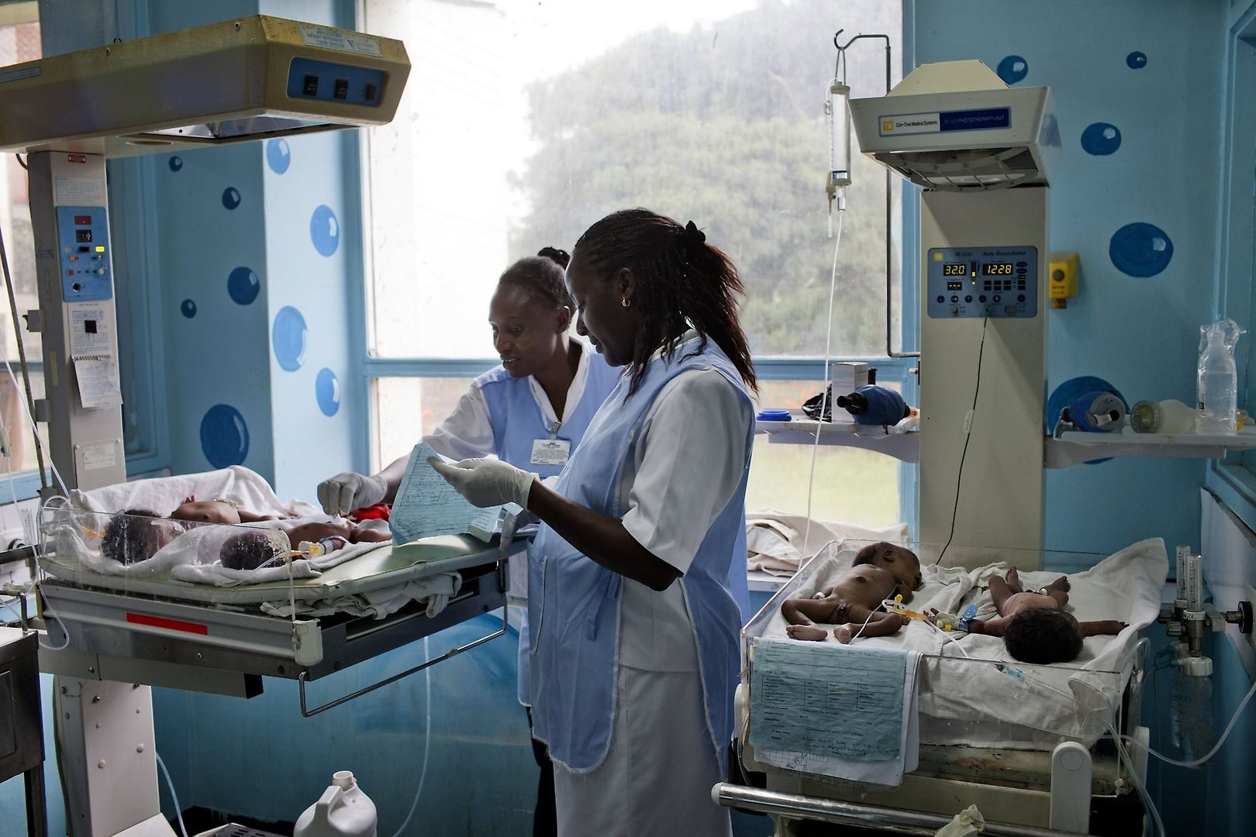
Understanding the work done by nurses for sick newborns
What should be done
Standards of care
What is being done
Work and task analysis
Missed care
  Direct observations (216 babies)
  Nurse self-reported survey (400 nurses)
How it can be done
Experts & stakeholders
Context
  Task sharing in practice
  Nurses’ perception of QoC across sectors
  Patient experiences

Slide 8
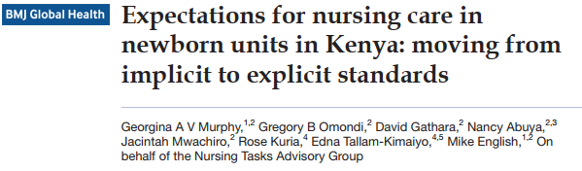
Task Area | Task done by | Frequency (minimum daily requirement) | Comment
Routine vital signs and monitoring
Temperature (including incubator temperature) | Nurse | Normal: 4 times daily/6 hourly Category C patients: 2 times daily/12 hourly | KMC newborns: Vital signs monitoring and monitoring of general clinical condition
Pulse | Nurse
Respiration | Nurse
Checking and documenting oxygen saturation for babies not on oxygen (for babies on oxygen see section below). | Nurse | 4 times daily/6 hourly | Although it is recognized that the availability of pulse oximeters is limited at present, checking oxygen saturation in sick babies not on oxygen should be promoted.
Skin colour | Nurse | Normal: 4 times daily/6 hourly Category C patients: 2 times daily/12 hourly | Conduct together with vital signs monitoring
Jaundice | Nurse
Respiratory effort | Nurse
Abdominal distension | Nurse
Weight | Nurse/clinician | Alternate days
Input/output - general | Nurse | 4 times daily/6 hourly
Input - IV fluids | Nurse/clinician | Frequency depends on prescription. Infusion rate checked and documented 3 hourly. | Conduct together with vital signs
Input/output documentation (amount that has been infused) | Nurse | 3 hourly

Slide 9
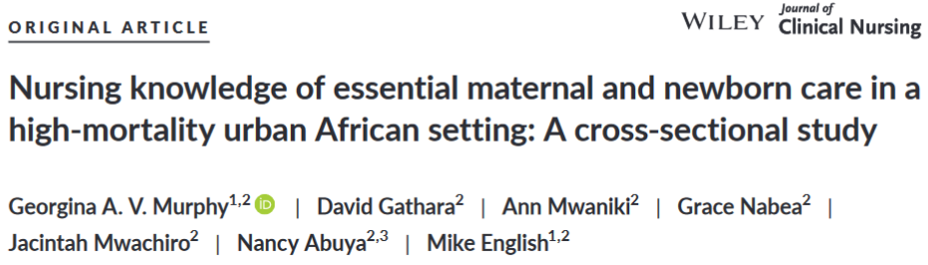

Slide 10
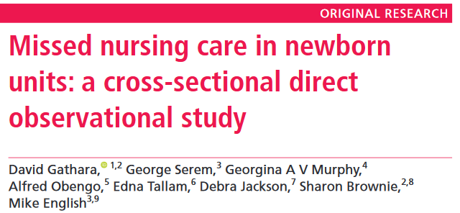
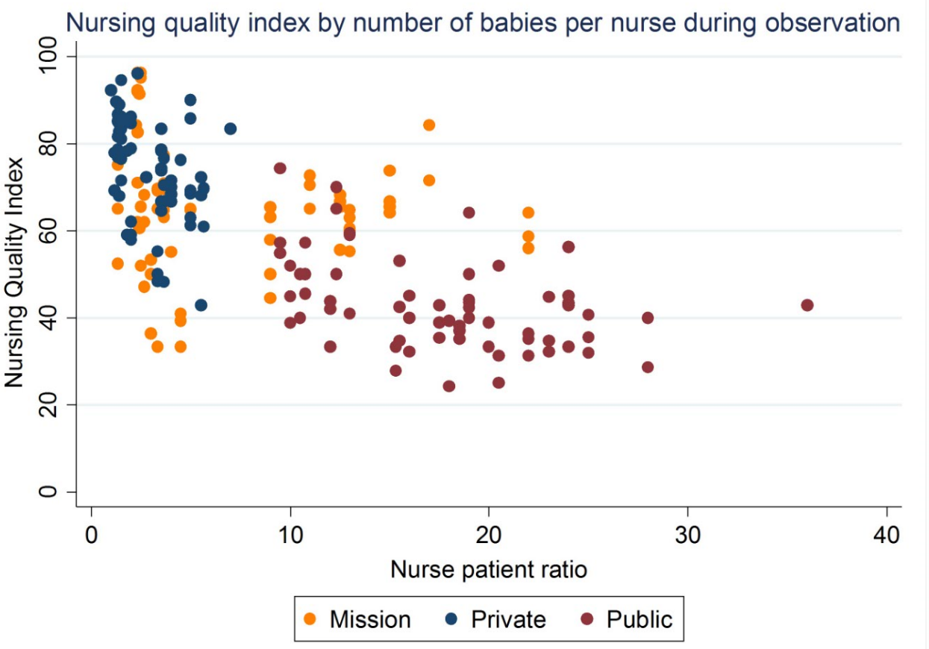

Slide 11
The impossible job of nursing
Dr. Jacinta Nzinga
Post-Doctoral Researcher
KEMRI -Wellcome Trust
Notes:
Work developed in collaboration with the county

Slide 12
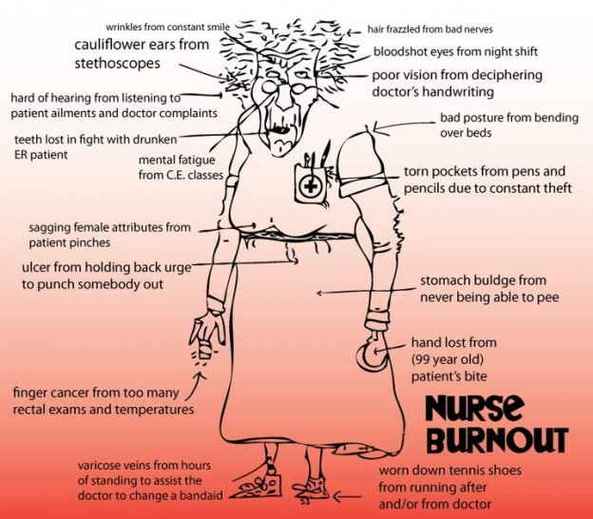

Slide 13
Issues influencing nursing practice
Basic issues Numbers of nursing staff available, Ratios and Material shortages; drug and failing equipment and facilities Commuting times; busy personal lives; Second jobs and education
Meso issues Secondary issues create additional opportunities for failure. Poor HRH management, supervision and accountability, Scandals and poor reputation and morale; Policy implementation and regulatory functions
Nurse Identity Nursing identity is at the core of the issue-Cannot be addressed without interventions that target the basic and Meso issues. Nursing ID, professional profiling and routines e.g. subconscious triage allow nurses to cope, but are themselves problematic and constitute barriers to care

Slide 14

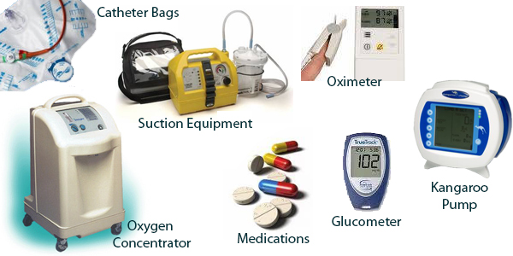
Basic stresses
Material and drug shortages
HR shortages –low nurse: patient ratio
Poor and delayed salaries
‘Moon-lighting’-locums

Slide 15
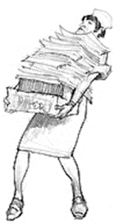
Meso level issues
Role clarity & task allocation
    Trained staff not working in an appropriate area –frequent rotations
    Huge amount of documentation vs time for clinical work
    Lack of ‘realistic’ training to match desperate working conditions
HRM considerations
  General HRM issues-staffing norms and deployment practices
  Current supervision, accountability and regulatory arrangements
  Policy issues-Nursing standards
Low morale
  Blame culture
  Focus on scandals
  Lack of agency and sense of helplessness

Slide 16

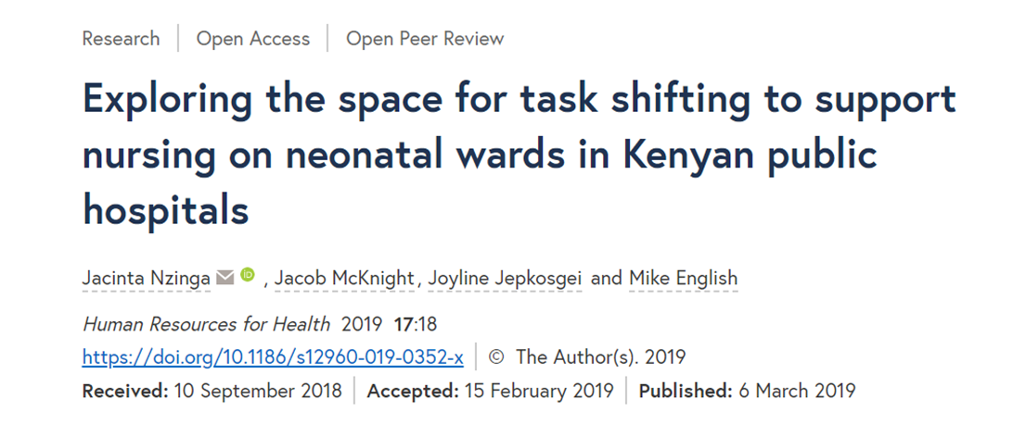
Identity issues… from our past work
There appeared to be a hierarchy practice when it came to delegation e.g. junior nurses did not delegate to others unless advised by the more senior and experienced nurses
Nurses agnostic about T/S
  Questions around what competencies new cadre would have
  Skepticism on whether task sharing would mean more supervision and therefore an additional responsibility to nurses
  Fear that new cadre would be working beyond their scope of practice
  Avoidance of ‘nurse’ in the title of any TS position with a preference for ‘patient assistant’, ‘healthcare assistant’ etc.

Slide 17
Our research focus going forward…
Professional identities of nursing-understanding shared meanings of “who we are collectively”.
  The existence of a shared identity provides a useful frame for interpreting nursing work activities and their agency in decision making.
  Encourages the investigation of the actual behavior of nurses and how this influences outcomes rather than considering roles as formulated intentions
Linking nursing identity to the role of nursing in leadership and management
  Identify and position nursing leadership strategically in organizational structures at all levels of the health system
  Increased growth of leadership numbers of nurses involved in academic issues pertaining to health and nursing
Examining nursing well-being at work (with colleagues in Makerere and Lira)
  To understand the relationship between engagement and wellbeing/health perceptions in the health context and in the wider workforce

Slide 18
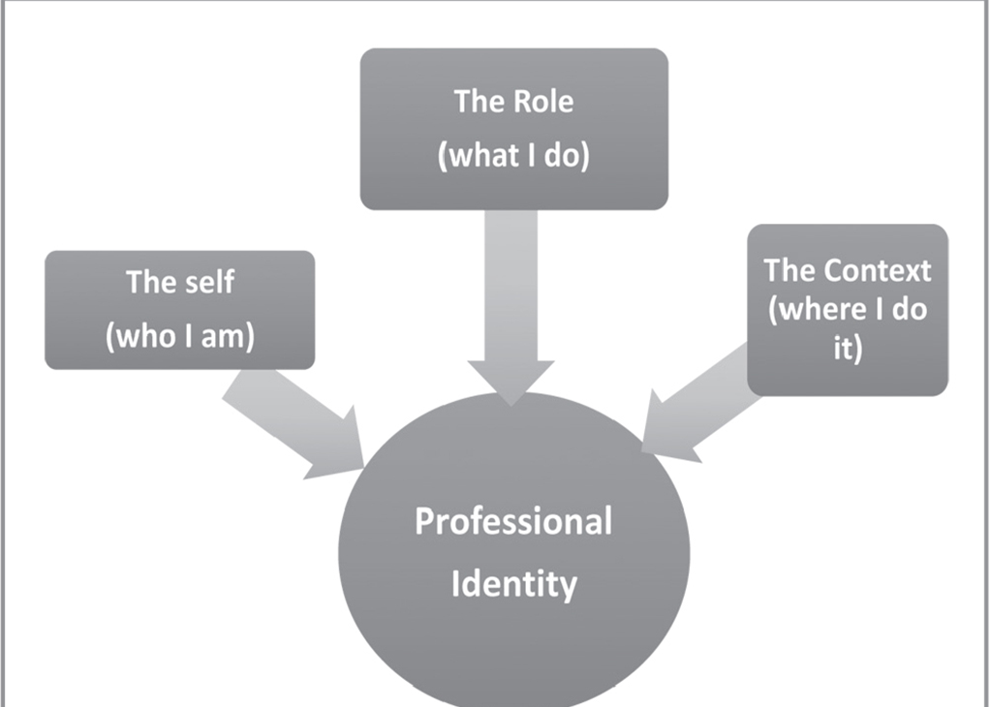
Nursing identity in leadership and management
How nursing socialization their professional identity the ability of nurses to mobilize power and authority within the health care system.
We will explore nurses' professional identity and leadership role and their influence in practice at national, county and hospital levels through;
  ethnography, interviews with frontline nurses, nurse managers at hospital and county levels and stakeholder meetings

Slide 19
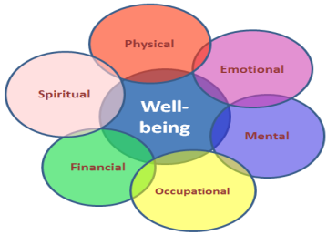
Nurse well-being and healthy work environments
Higher number of sick days; miss work due to injury, illness, depression or fatigue
More likely to have workplace errors
More likely to be impatient and reactive to fellow colleagues and patients and families
More likely to change jobs

Slide 20
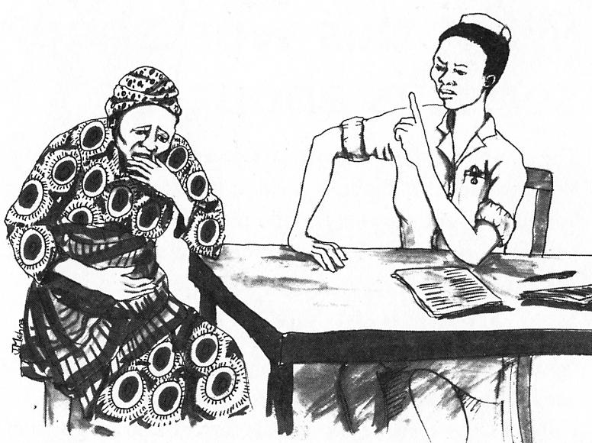
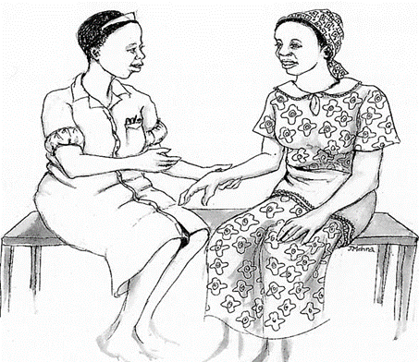
Intervening for healthy nurses
Research has shown that these elements create healthy work environments;
Skilled communication
True collaboration
Authentic leadership
Meaningful recognition
Effective decision making
Appropriate staffing
Basic communication and emotional management course (KWTRP to select hospitals). Aims
  To strengthen providers ’ awareness of what facilitates and hinders good communication with patients and colleagues
  To strengthen providers skills to communicate professionally with respect and to manage own and patients emotions.

Slide 21
What should we do?
Increasing the nursing workforce is a pre-requisite to improving care
Stakeholder engagement and co-design of interventions
There is need to re-focus the nursing practice to allow nurses to concentrate on technical nursing roles
Review and generate local evidence on how to enhance and support the nursing workforce
Package and present evidence to policy makers (finance) and partner organizations to invest in human resource

Slide 22



We must work together as nursing community and with others
Participants drawn from: Ministry of Health, Nairobi City County, UNICEF-Kenya, the Nursing Council of Kenya, the Midwives Association of Kenya, Aga Khan University, University of Nairobi, Kenyatta University, Kenyatta National Hospital and others
Policy makers
Practitioners
Training institutions
Funding agencies
Patient groups
Researchers

