Slide 1
Leadership 101
Barbara A. Ihrke, PHD, RN

Slide 2
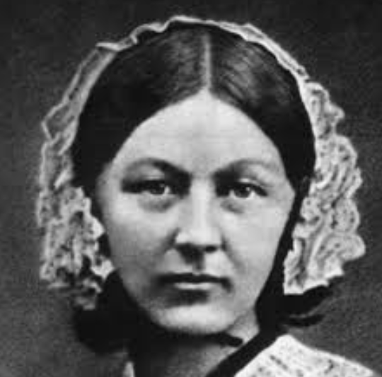
Leadership 101
Nurses are leaders – caring for the lives of others
Work
Family
Church
Nurses are Healthcare leaders
Educators
Changing the path of Healthcare
Nurses are Spiritual leaders
Family
Church
Work

Slide 3
Leadership 101 – Are you a Leader?
My story
Family
Speech Therapy
Education
God’s Call
Your story
Family
Your struggle
Education
God’s call

Slide 4
Leadership 101
Leadership:
a process of influence of others toward goal achievement
Sharing a vision
Commitment to work
Succession Planning
Leadership Depends on:
Leader-Staff Relations
Informal leaders
Work structure
Position/Power

Slide 5
Leadership: Novice to Expert
Clinical Practice (Benner)
Novice – no experience
Advanced beginner – marginally competent
Competent – 2-4 years of experience
Proficient – Perceives situations as a whole, what to do in typical situations
Expert – intuitive grasp of situations, able to grasp the key element
Nursing Leadership
Novice
Advanced beginner
Competent
Proficient
expert

Slide 6
Leadership: Novice to expert
Future of Nursing: Leading Change, Advancing Health
Policy
Politics
Organizations
Practice
Strategic planning – futuristic thinking
Be Present
Stop accepting the default
Learn new things
Make life simple

Slide 7
Leadership: Novice to expert
Mentoring
Collaborative skills
Professional development
Lead situationally
directing
Coaching
Guiding
Delegating
Commitment to professional values
Integrity, accountability, Excellence, Professional duty, compassion, social responsibility

Slide 8
Leadership: 101
Develop a team
Care about each other
Be aware of what is important
Great communication

Slide 9
Leadership: 101
Confidence in the Team
Group interests above Personal interests
Each member is important

Slide 10
Leadership: 101
Mentor the next team of leaders (succession planning)
Sense of what direction the work is going
willing to go the extra kilometer for the team

Slide 11
Leadership 101
our Profession is Nursing
our calling is to Serve God with our profession
We are nurse leaders and we are spiritual leaders

Slide 12
Leadership in Nursing
Nurses are spiritual leaders – Being, Caring, Advocating, loving
Being
Caring
advocating
loving
Sharing hope, healing, and Health
Notes:
Cynics, skeptics about faith
Cultivating – addresses the Emotional barriers
Spectators to faith
Sowing – Speaks to the mind
Seeker of Faith
Harvesting – speaks to the will

Slide 13
Leadership: 101
Leadership journey
Member of the team
Leader of the team
Focus is on Godly service
Colossians 3: 12-14 Therefore, as God’s chosen people, holy and dearly loved, clothe yourself with compassion, kindness, humility, gentleness and patience. Bear with each other and forgive whatever grievances you may have against one another. Forgive as the Lord forgave you. And over all these virtues put on love, which binds them all together in perfect unity.

Slide 14
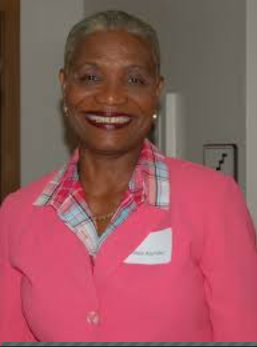
Review
Nurse Leaders
Do you have the knowledge, skills, Attitude to be a nurse leader?
Do you accept new roles?
Are you preparing for your next role?
Are you willing to change?
Are you seeking mentors/coaching?
Take the Next step in your leadership journey!

Slide 15
Questions?

Slide 16
References
Benner, P. (1984). From novice to expert: Excellence and power in clinical nursing practice. Menlo Park, CA: Addison-Wesley Publishing.
Maxwell, J. C. (2008). Travail D’Equipe 101. Nashville, TN: Thomas Nelson.
Maxwell, J. C. (2002). Les 21 lois irrefutables du leadership: Suivez-les et les autres vous suivront. Nashville, TN: Thomas Nelson
Mazzoccoli, A. (2016). Mentoring through the leadership journey: From novice to expert. Nurse leader, 14(4), 253-256.
Walker-Reed, C. A. (2016). Clinical coaching: The means to achieving a legacy of leadership and professional development in nursing practice. Journal of Nursing Education and Practice, 6(6), 41-47.

